Slide 1
Digital Image fundamentals

Slide 2
Digital Image
— a two-dimensional function
x and y are spatial coordinates
The amplitude of f is called intensity or gray level at the point (x, y)
Digital Image Processing
— process digital images by means of computer, it covers low-, mid-, and high-level processes
low-level: inputs and outputs are images
mid-level: outputs are attributes extracted from input images
high-level: an ensemble of recognition of individual objects
Pixel
— the elements of a digital image

Slide 3
Sources for Images
Electromagnetic (EM) energy spectrum
Acoustic
Ultrasonic
Electronic
Synthetic images produced by computer

Slide 4
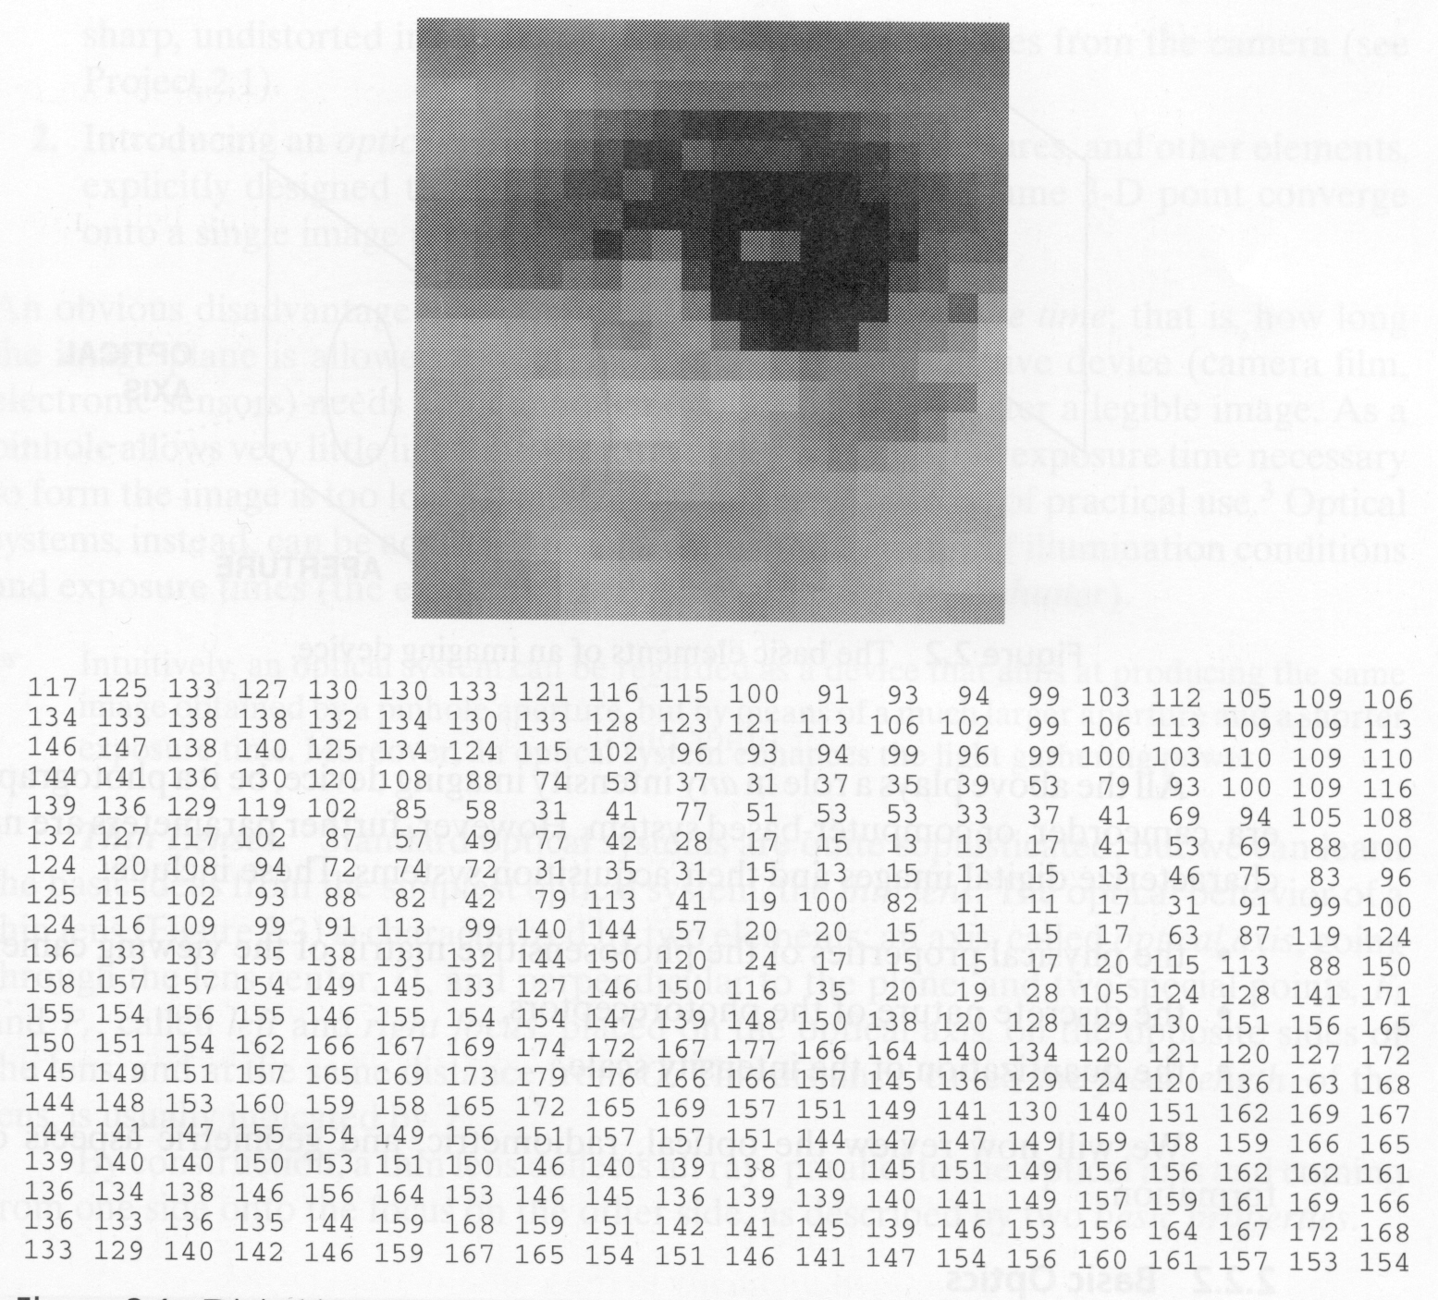
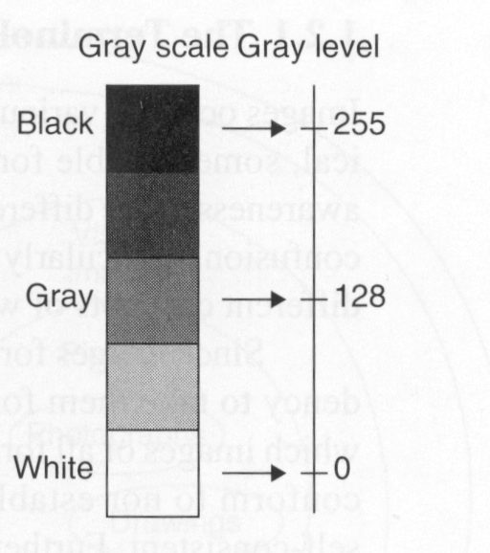
What is an image?
8 bits/pixel
0
255

Slide 5
How Images are Represented
Bitmap images (Dots used to draw the image)
Monochrome images
8 bit grey scale images
24 bit colour
Colour lookup tables
Vector Graphics (Line art)
Rasterisation
Two key concepts
Image resolution
Colour resolution

Slide 6
Fundamental Steps in DIP
Extracting image components
Improving the appearance
Partition an image into its constituent parts or objects
Result is more suitable than the original
Represent image for computer processing

Slide 7
Image Acquisition
Transform illumination energy into digital images

Slide 8
Image Acquisition Using a Single Sensor

Slide 9
Image Acquisition Using Sensor Strips

Slide 10

Image Acquisition Process

Slide 11
A Simple Image Formation Model

Slide 12
Some Typical Ranges of illumination
Illumination
Lumen — A unit of light flow or luminous flux
Lumen per square meter (lm/m²) — The metric unit of measure for illuminance of a surface
On a clear day, the sun may produce in excess of 90,000 lm/m² of illumination on the surface of the Earth
On a cloudy day, the sun may produce less than 10,000 lm/m² of illumination on the surface of the Earth
On a clear evening, the moon yields about 0.1 lm/m² of illumination
The typical illumination level in a commercial office is about 1000 lm/m²

Slide 13
Some Typical Ranges of Reflectance
Reflectance
0.01 for black velvet
0.65 for stainless steel
0.80 for flat-white wall paint
0.90 for silver-plated metal
0.93 for snow

Slide 14
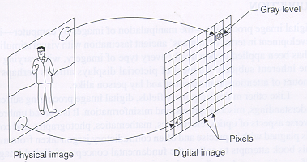
Image Quantization
Sampling: measure the value of an image at a finite number of points.
Quantization: represent measured value (i.e., voltage) at the sampled point by an integer.

Slide 15
Image Sampling and Quantization
Digitizing the coordinate values
Digitizing the amplitude values

Slide 16
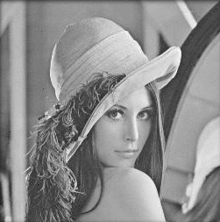


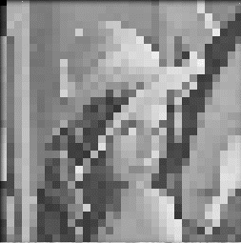
Image Sampling – Example
Original image Sampled by a factor of 2
Sampled by a factor of 4 Sampled by a factor of 8

Slide 17
Image Sampling and Quantization

Slide 18

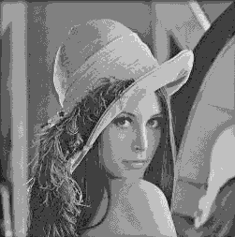
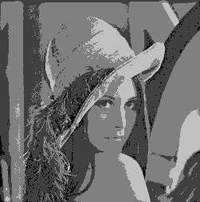
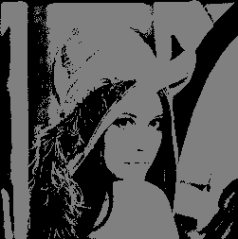
Image Quantization
256 gray levels (8bits/pixel) 32 gray levels (5 bits/pixel) 16 gray levels (4 bits/pixel)
8 gray levels (3 bits/pixel) 4 gray levels (2 bits/pixel) 2 gray levels (1 bit/pixel)

Slide 19
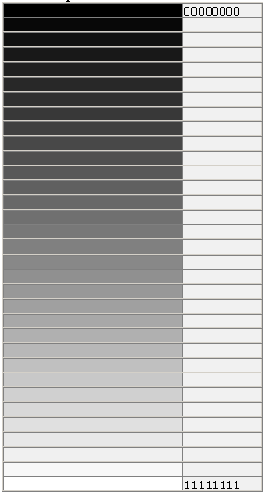
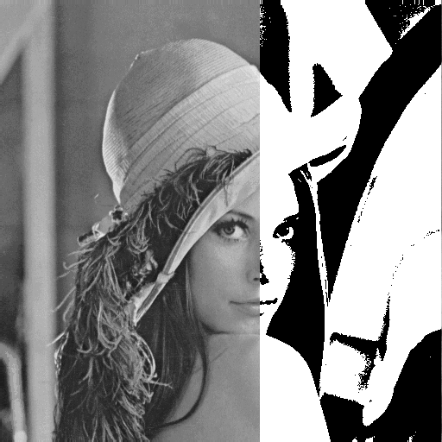
Image Quantization
8 Bit Grey Scale Images Vs Binary Image

Slide 20
Representing Digital Images

Slide 21
Representing Digital Images
The representation of an M×N numerical array as

Slide 22
Representing Digital Images
The representation of an M×N numerical array as

Slide 23
Representing Digital Images
The representation of an M×N numerical array in MATLAB

Slide 24
Representing Digital Images
Discrete intensity interval [0, L-1], L=2^{k}
The number b of bits required to store a M × N digitized image
b = M × N × k

Slide 25
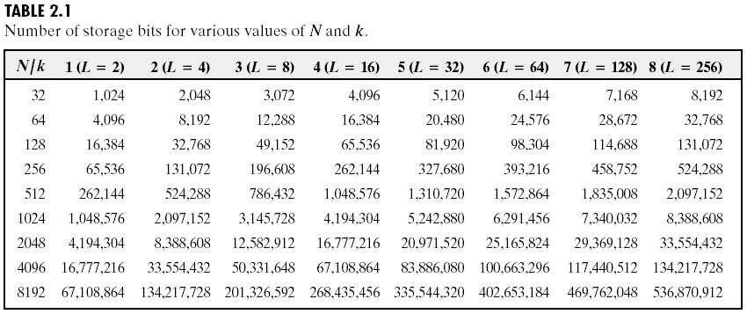
Representing Digital Images

Slide 26
Spatial and Intensity Resolution
Spatial resolution
— A measure of the smallest discernible detail in an image
— stated with line pairs per unit distance, dots (pixels) per unit distance, dots per inch (dpi)
Intensity resolution
— The smallest discernible change in intensity level
— stated with 8 bits, 12 bits, 16 bits, etc.

Slide 27
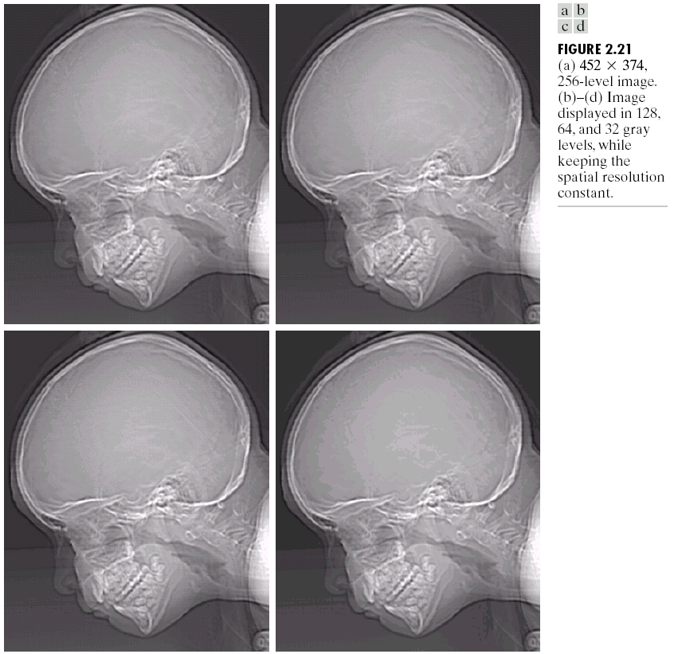

Spatial and Intensity Resolution

Slide 28
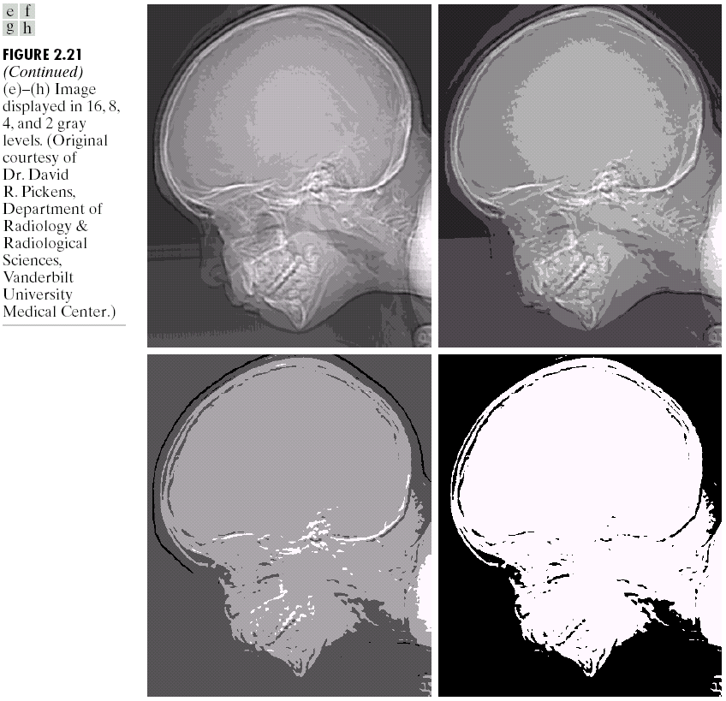
Spatial and Intensity Resolution

Slide 29

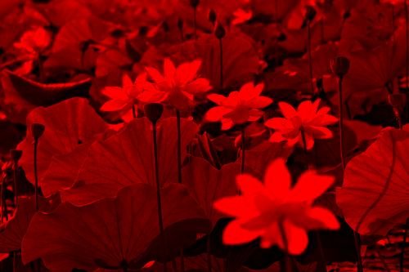
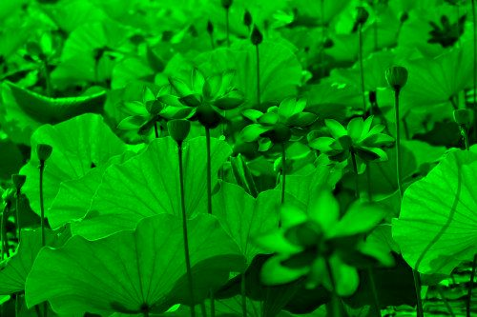
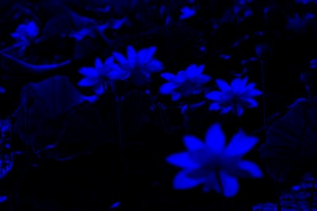
Color Images
Color images are comprised of three color channels – red, green, and, blue – which combine to create most of the colors we can see

Slide 30
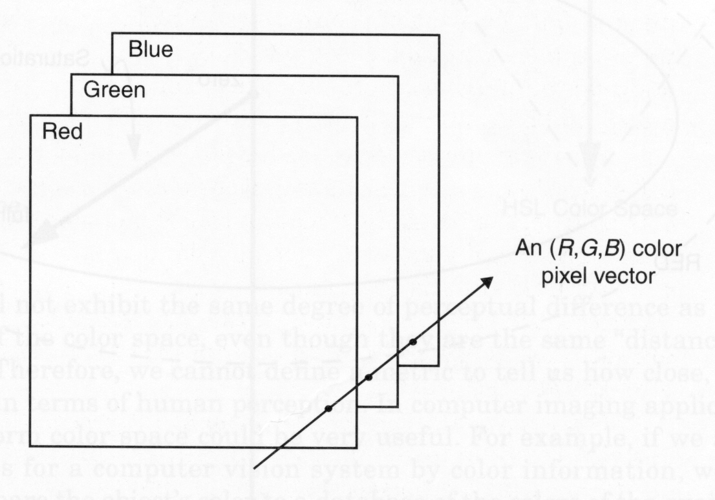
Color Images

Slide 31
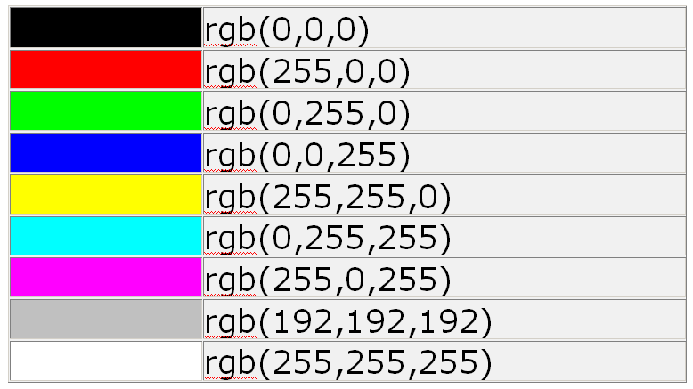
Color Images
This time a single pixel is made up of 3 bytes or 24 bits.

Slide 32
Alternative Color Spaces
Various other color representations can be computed from RGB.
This can be done for:
Decorrelating the color channels:
principal components.
Bringing color information to the fore:
Hue, saturation and brightness.
Perceptual uniformity:
CIELuv, CIELab, …

Slide 33
8 bit Colour Images and Look up Tables
Draw three blue dots
Pixel | Red | Green | Blue
1 RGB(0,0,255) | 0 (1 byte) | 0 (1 byte) | 255 (1 byte)
2 RGB(0,0,255) | 0 (1 byte) | 0 (1 byte) | 255 (1 byte)
3 RGB(0,0,255) | 0 (1 byte) | 0 (1 byte) | 255 (1 byte)
4 RGB(0,0,255) | 0 (1 byte) | 0 (1 byte) | 255 (1 byte)
No of bytes = 12

Slide 34
Processing Strategy
Red
Red
Green
Green
T
Processing
T⁻¹
Blue
Blue

Slide 35
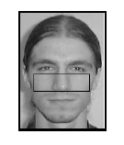
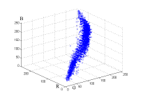
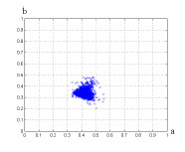
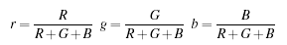
Skin color
RGB
rg
r
g

Slide 36
Skin detection
M. Jones and J. Rehg, Statistical Color Models with Application to Skin Detection, International Journal of Computer Vision, 2002

Slide 37
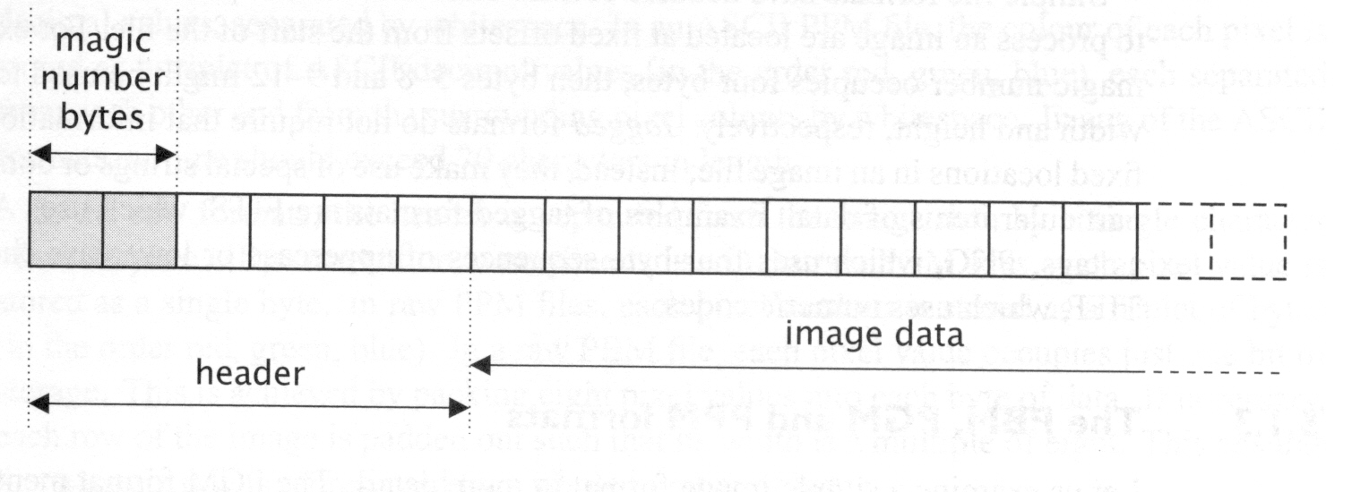
Image file formats
Many image formats adhere to the simple model shown below (line by line, no breaks between lines).
The header contains at least the width and height of the image.
Most headers begin with a signature or “magic number”
(i.e., a short sequence of bytes for identifying the file format)

Slide 38
Common image file formats
GIF (Graphic Interchange Format)
PNG (Portable Network Graphics)
JPEG (Joint Photographic Experts Group)
TIFF (Tagged Image File Format)
PGM (Portable Gray Map)
FITS (Flexible Image Transport System)

Slide 39
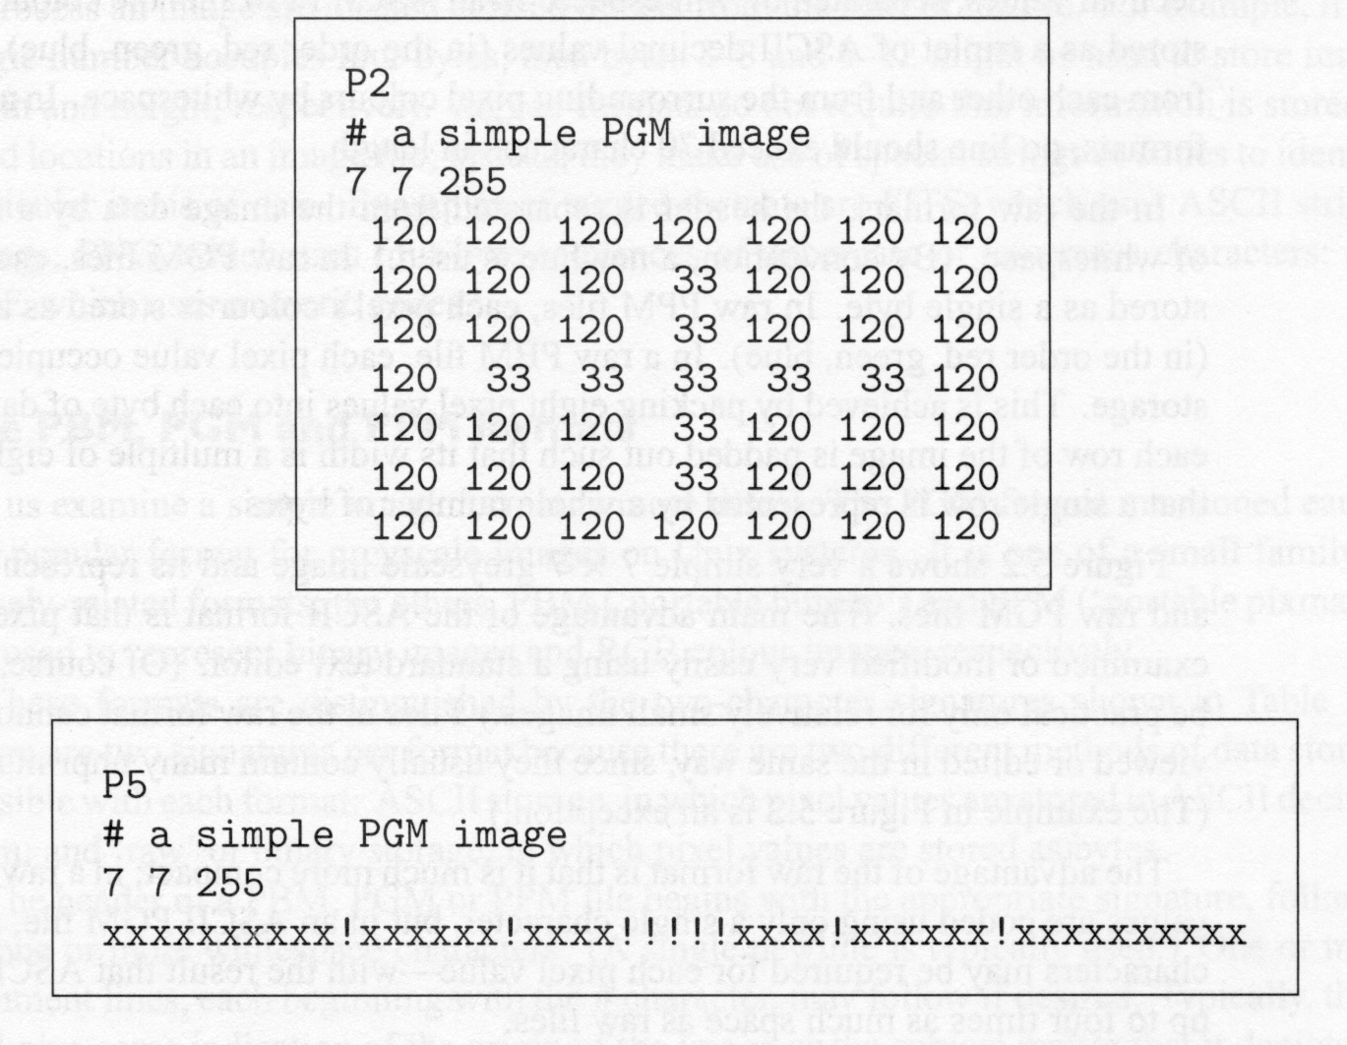
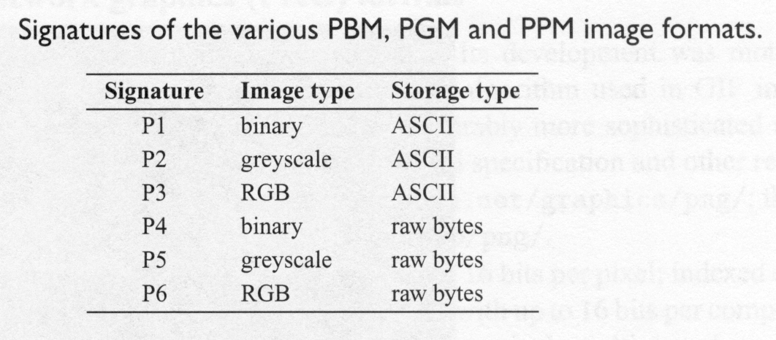
PBM/PGM/PPM format
A popular format for grayscale images (8 bits/pixel)
Closely-related formats are:
PBM (Portable Bitmap), for binary images (1 bit/pixel)
PPM (Portable Pixelmap), for color images (24 bits/pixel)
ASCII or binary (raw) storage

Slide 40
Representing Digital Images
Digital images are composed of PIXELS (or picture elements)
a natural image is typically represented by a continuous or analog signal (such as a photograph, video frame, etc.)
Digitizing samples the natural image into discrete components

Slide 41
Representing Digital Images
Digital images are composed of PIXELS (or picture elements)
Each discrete sample is averaged to represent a uniform value for that area in the image
PICTURE RESOLUTION is the number of pixels or samples used to represent the image

Slide 42
Representing Digital Images
Digital images are composed of PIXELS (or picture elements)
ASPECT RATIO expresses this resolution as the product of the no. of horizontal pixels by the no. of vertical pixels
this image is square, 50 X 50
sample ratios are 320 X 200 or 1.6:1, 640 X 480, 800 X 600, and 1024 X 768--all of which are 1.33:1

Slide 43
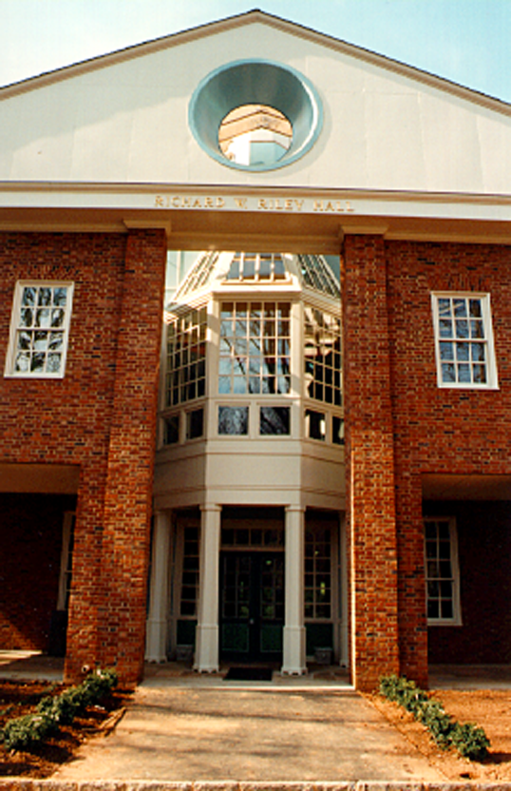
Representing Digital Images
Picture resolution determines both the amount of detail as well as its storage requirements
here is a (edited) digitized image with a resolution of 272 X 416

Slide 44
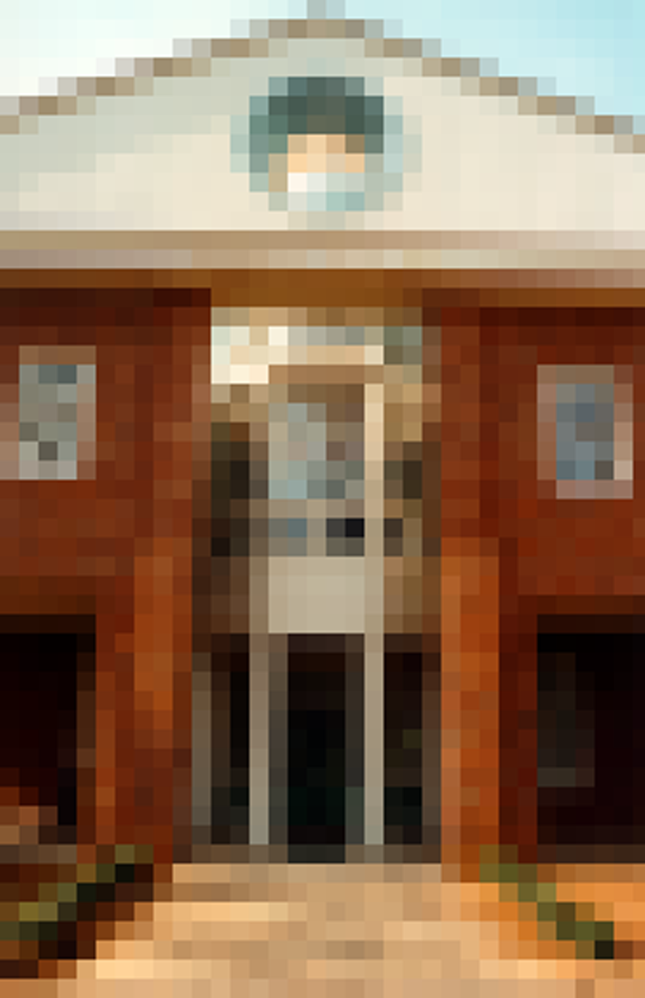
Representing Digital Images
Picture resolution determines both the amount of detail as well as its storage requirements
notice more changes when the resolution is reduced (68 X 104)

Slide 45

Representing Digital Images
Picture resolution determines both the amount of detail as well as its storage requirements
notice the changes when the resolution is reduced (136 X 208)

Slide 46
Image Size
“image size” refers to both
Picture resolution
Physical dimensions of the image
the physical dimensions of the image are determined by
the number of pixels in the image (resolution) and
the characteristics of the output device

Slide 47
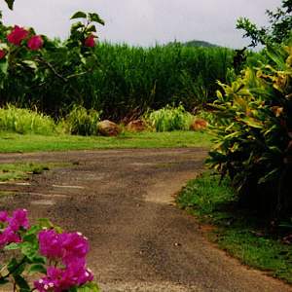

Image Size
Here are
an image with a resolution of 300 X 300 at 72 dpi.
And
with a resolution of 300 X 300 at 300 dpi.

Slide 48
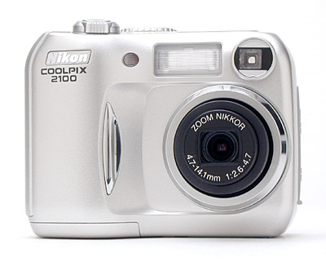
Spatial Resolution
The spatial resolution of an image is determined by how sampling was carried out
Spatial resolution simply refers to the smallest discernible detail in an image
Vision specialists will often talk about pixel size
Graphic designers will talk about dots per inch (DPI)

Slide 49
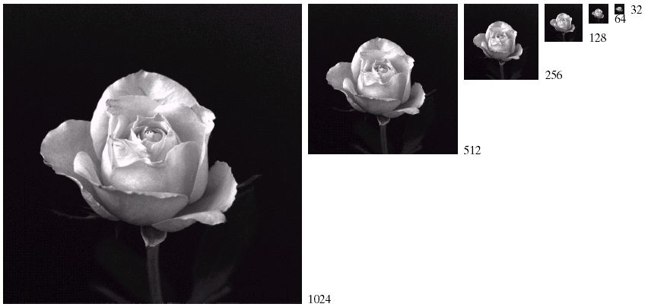
Spatial Resolution (cont…)

Slide 50
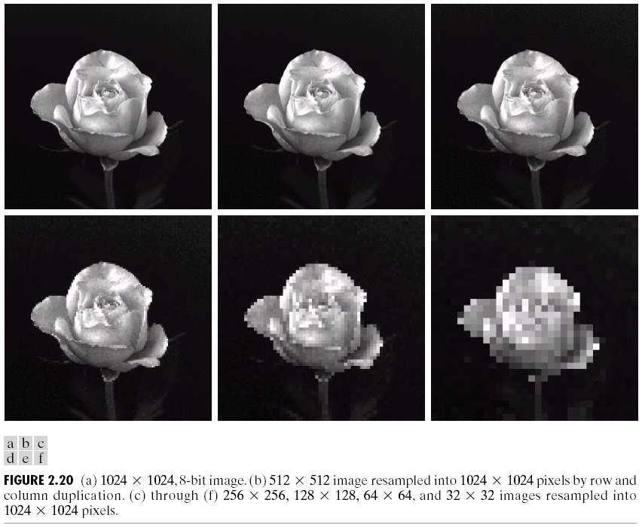
Spatial Resolution (cont…)

Slide 51
Spatial Resolution (cont…)

Slide 52

Spatial Resolution (cont…)
Images taken from Gonzalez & Woods, Digital Image Processing (2002)

Slide 53
Spatial Resolution (cont…)
Images taken from Gonzalez & Woods, Digital Image Processing (2002)

Slide 54
Spatial Resolution (cont…)
Images taken from Gonzalez & Woods, Digital Image Processing (2002)

Slide 55
Spatial Resolution (cont…)
Images taken from Gonzalez & Woods, Digital Image Processing (2002)

Slide 56
Intensity Level Resolution
Intensity level resolution refers to the number of intensity levels used to represent the image
The more intensity levels used, the finer the level of detail discernable in an image
Intensity level resolution is usually given in terms of the number of bits used to store each intensity level
Number of Bits
Number of Intensity Levels
Examples
1
2
0, 1
2
4
00, 01, 10, 11
4
16
0000, 0101, 1111
8
256
00110011, 01010101
16
65,536
1010101010101010

Slide 57
Intensity Level Resolution (cont…)
256 grey levels (8 bits per pixel)
128 grey levels (7 bpp)
64 grey levels (6 bpp)
32 grey levels (5 bpp)
Images taken from Gonzalez & Woods, Digital Image Processing (2002)
16 grey levels (4 bpp)
8 grey levels (3 bpp)
4 grey levels (2 bpp)
2 grey levels (1 bpp)

Slide 58
Intensity Level Resolution (cont…)
Images taken from Gonzalez & Woods, Digital Image Processing (2002)

Slide 59
Intensity Level Resolution (cont…)
Images taken from Gonzalez & Woods, Digital Image Processing (2002)

Slide 60
Intensity Level Resolution (cont…)
Images taken from Gonzalez & Woods, Digital Image Processing (2002)

Slide 61
Intensity Level Resolution (cont…)
Images taken from Gonzalez & Woods, Digital Image Processing (2002)

Slide 62
Intensity Level Resolution (cont…)
Images taken from Gonzalez & Woods, Digital Image Processing (2002)

Slide 63
Intensity Level Resolution (cont…)
Images taken from Gonzalez & Woods, Digital Image Processing (2002)

Slide 64
Intensity Level Resolution (cont…)
Images taken from Gonzalez & Woods, Digital Image Processing (2002)

Slide 65
Intensity Level Resolution (cont…)
Images taken from Gonzalez & Woods, Digital Image Processing (2002)

Slide 66
Saturation & Noise
Images taken from Gonzalez & Woods, Digital Image Processing (2002)

Slide 67
Resolution: How Much Is Enough?
The big question with resolution is always how much is enough?
This all depends on what is in the image and what you would like to do with it
Key questions include
Does the image look aesthetically pleasing?
Can you see what you need to see within the image?

Slide 68
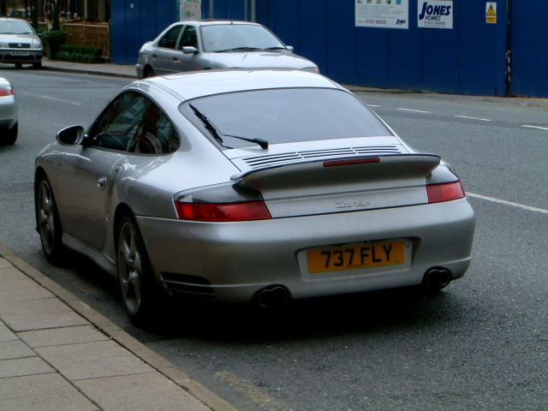

Resolution: How Much Is Enough? (cont…)
The picture on the right is fine for counting the number of cars, but not for reading the number plate

Slide 69
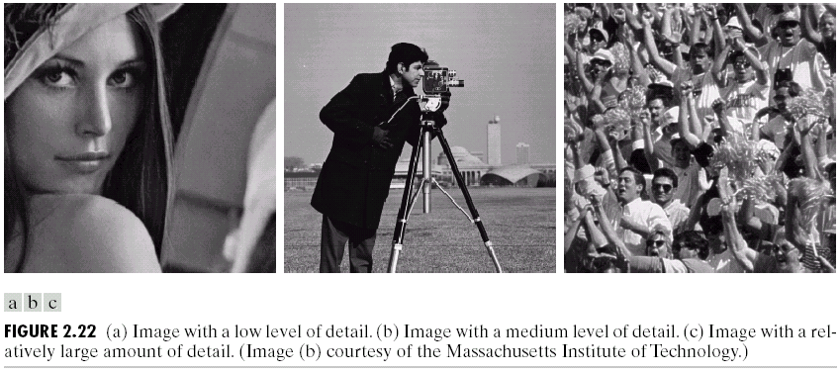
Intensity Level Resolution (cont…)
Images taken from Gonzalez & Woods, Digital Image Processing (2002)
Low Detail
Medium Detail
High Detail

Slide 70
Intensity Level Resolution (cont…)
Images taken from Gonzalez & Woods, Digital Image Processing (2002)

Slide 71
Intensity Level Resolution (cont…)
Images taken from Gonzalez & Woods, Digital Image Processing (2002)

Slide 72
Intensity Level Resolution (cont…)
Images taken from Gonzalez & Woods, Digital Image Processing (2002)

Slide 73
END

